Slide 1
Customer Prioritization for Sales
Packt Epic Team Project

Slide 2









The Problem
From the thousands of customers visiting our website everyday, the sales team needs to reach out and make as many conversions as possible.

Slide 3


Expected Solution
ML
Optimize the prediction model and return a list of top 250 customers in order of their conversion probabilities.

Slide 4





The data
The data provided to create and evaluate ML models.
Dataset | Shape
Beacons | 6970265 rows X 4 cols
Sessions | 9095602 rows X 10 cols
Customers | 2295101 rows X 5 cols
Transactions | 3304478 rows X 5 cols
Products | 4179025 rows X 4 cols

Slide 5




Development process
Explore, prepare, build, evaluate.

Slide 6
Model Evaluation
Model | BAC | REC
SGD1 fs1 std scaled | 0.979 | 0.927
SGD1 fs3 std scaled | 0.976 | 0.978
SGD1 fs4 std scaled | 0.967 | 0.955
SGD2 fs3 std scaled | 0.956 | 0.930
SGD2 fs4 std scaled | 0.956 | 0.930
Top 5 models obtained while training.

Slide 7
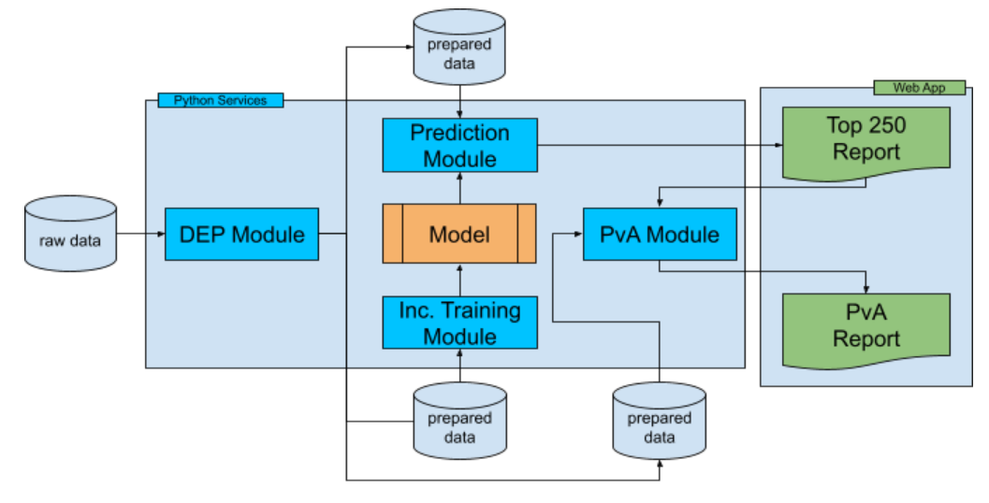
High Level Architecture
The parts that build our solution.

Slide 8


Challenges
Novice experience and unforeseen events.

Slide 9


Thank you!
Questions & Discussion
Owner : Rutuja Yerunkar
Lead / Instructor : Neeraj Garg
Data Scientist / Web App Developer: Rishav Sharma

